Slide 1
Work Progress
By: Abdur Rehman

Slide 2
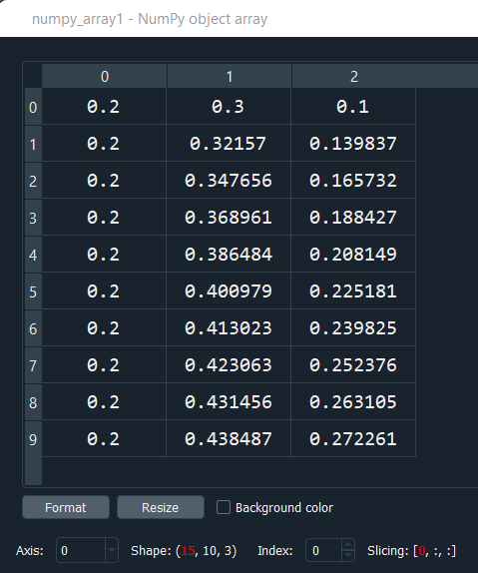
Model Training and Evaluation
Input used caIN as numpy_array:
array([1., 1., 1., 1., 1., 0., 0., 0., 0., 0., 1., 1., 1., 1., 1.])
numpy_array.shape:
Out[6]: (15,)
Output used as numpy_array1 for three states:
numpy_array1.shape:
Out[8]: (15, 10, 3)

Slide 3
For the training and testing of data, the data is split into 80% for the training and 20% testing:
X_train, X_test, y_train, y_test = train_test_split(numpy_array, numpy_array1, test_size=0.2,)
Reshaped the data to fit the model using reshape
X_train= np.reshape(X_train, X_train.shape + (1,))
X_test= np.reshape(X_test, X_test.shape + (1,))
y_train= y_train.reshape(12,30)
y_test= y_test.reshape(3,30)
Configure the network with optimizer, loss function and accuracy
network.compile(optimizer=keras.optimizers.RMSprop(lr=0.01), loss='mse’, metics=['mae’])
history = network.fit(X_train, y_train,validation_data=(X_test, y_test),epochs=100, batch_size=20)
history_dict = history.history
loss_values = history_dict['loss']
val_loss_values = history_dict['val_loss']
plt.figure()
plt.plot(loss_values, 'bo', label='training loss')
plt.plot(val_loss_values, 'r', label='val training loss')
network.evaluate(X_train,y_train)
network.evaluate(X_test,y_test)

Slide 4
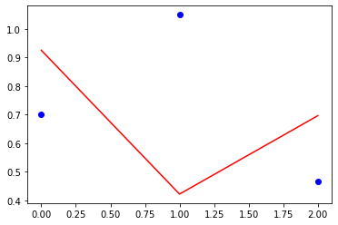
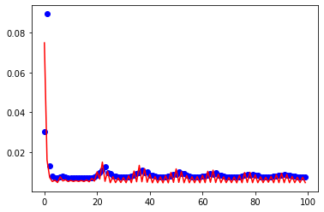
Training Loss:
Value Training Loss:

Slide 5
network.evaluate(X_train,y_train):
0.0579
network.evaluate(X_test,y_test):
0.0463

